Slide 1

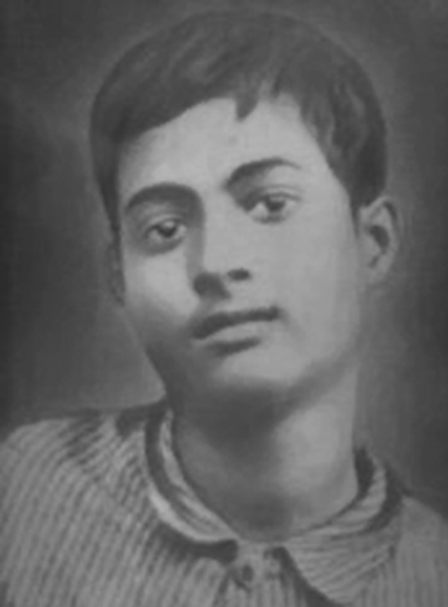
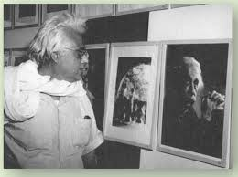
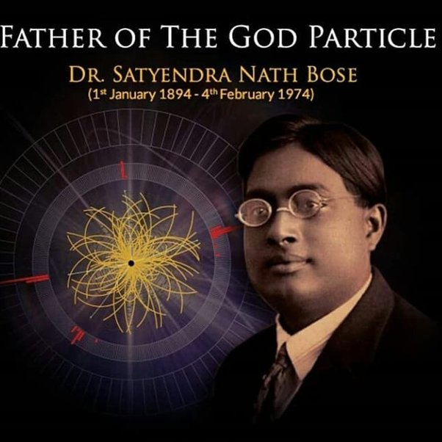
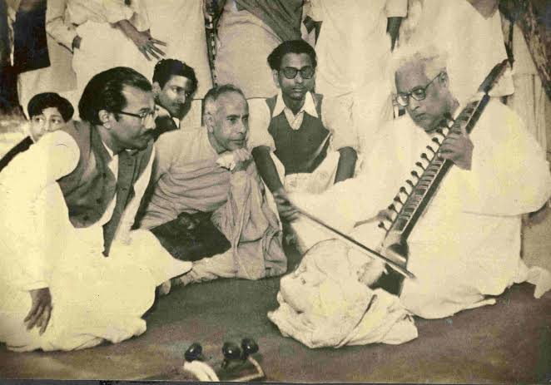
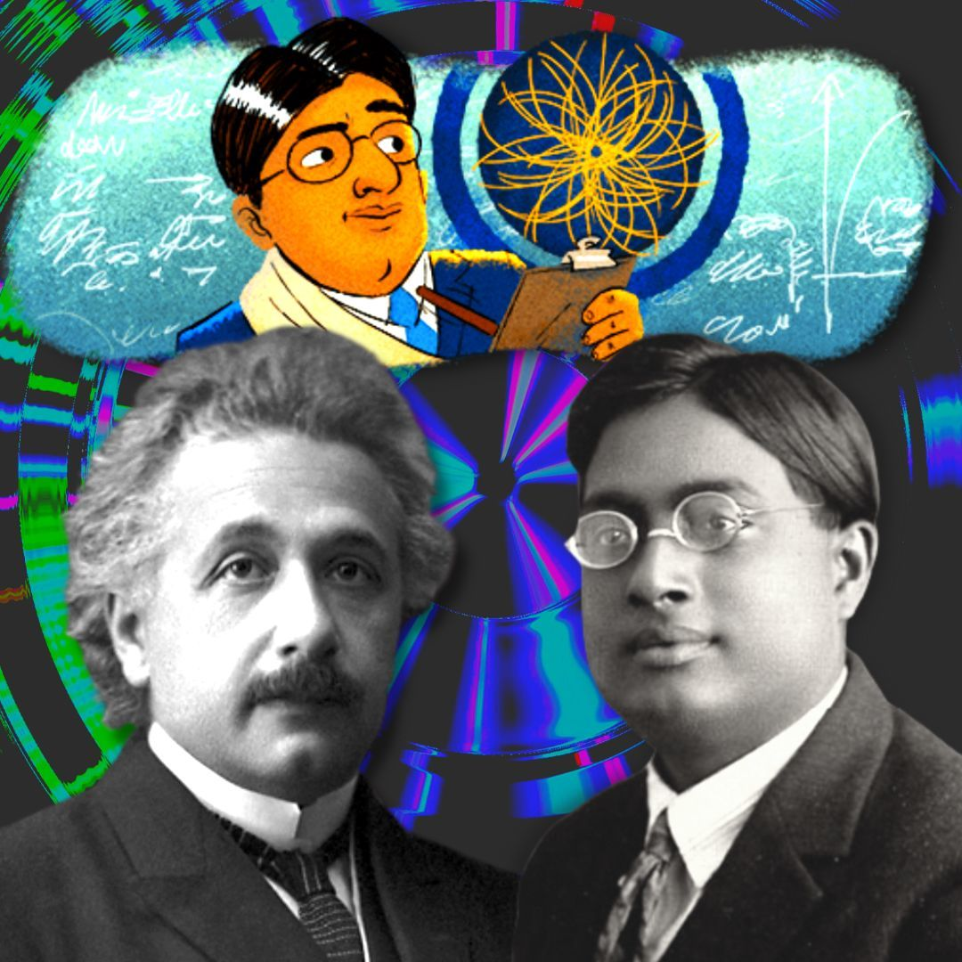
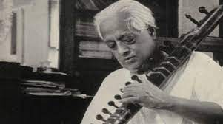
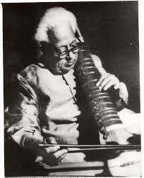
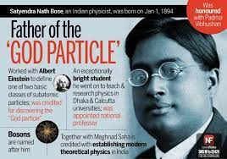
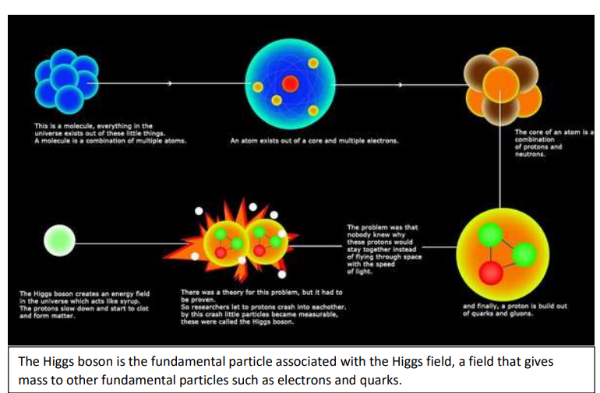
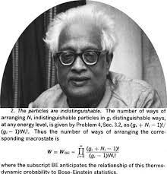
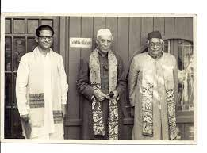
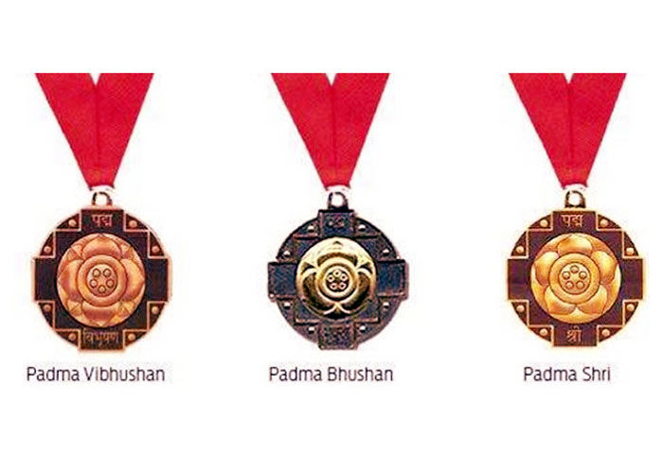
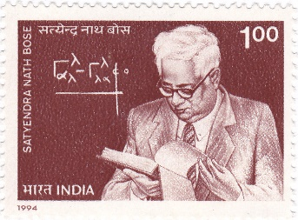
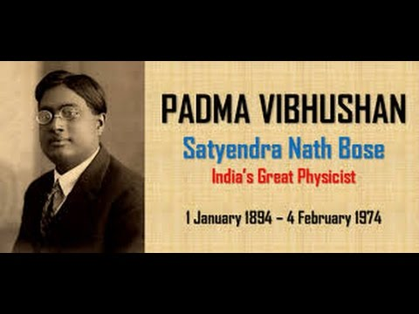
Satyendra Nath Bose
FARTHER OF THE GOD PARTICLE
Group 8
Section – B3
TASLIMA, ISHRAT JAHAN (23-50172-1)
BISWAS, EMON
(23-50174-1)
PRANTO, MD MINHAZ UL MOSTOFA (23-50176-1)
AHMED, IFTEKHAR
(23-50177-1)
HASAN, MD RIFAT
(23-50181-1)
PRIOTA, ARITRI ROY
(23-51531-1)
Short Biography
Hobby
Satyendra Nath Bose 1. Born : 1 January 1894 ( Calcutta, Bengal Presidency, British India). 2.Occupation: Mathematician, physicist. 3. Institution : University of Calcutta(1915),Presidency University (1909-1913), Hindu school. 4. Died : 4 February 1974 (aged 80) 5.Parents: Amodini Raichaudhuri , Surendranath Bose . (1,4)
Research
1.Described as the Father of the ‘God Particle’ in a 2012 New York Times report, Bose joined the group of scientists like Willard Gibb & Oswald Avery, who contributed tremendously, yet didn’t receive the Nobel prize.
2.To the field of quantum mechanics through his work on Bose-Einstein statistics, which describes the behavior of particles at extremely low temperatures.
3.Bose-Einstein statistics describe the behavior of particles that obey the laws of quantum mechanics and can occupy the same quantum state simultaneously, such as photons or bosons. (2,3,4)
S.N. Bose was a renowned musician known for his contribution to Indian classical music. His dedication and mastery of the Setara will always be remembered. (4)
Summary
Achievement
Satyendra Nath Bose was a pioneering Indian physicist whose work on quantum mechanics and statistics laid the foundation for Bose-Einstein condensates and the theory of elementary particles.
Reference
1.Satyendra Nath Bose – Bengali physicist.
2.Encyclopædia Britannica S. N. Bose Biography Project
3.Biographical Memoirs of Fellows of the Royal Society.
4.Wikipedia
Padma Bhushan & Padma Vibhushan(India), Fellow of the Royal society(United Kingdom), Bose on a 1994 stamp of India . (3,4)

